Slide 1
Regression Analysis
Regression Analysis in Practice
Nicoleta Serban, Ph.D.
Professor
Stewart School of Industrial and Systems Engineering
Emergency Department Healthcare Costs

Slide 2

About This Lesson

Slide 3

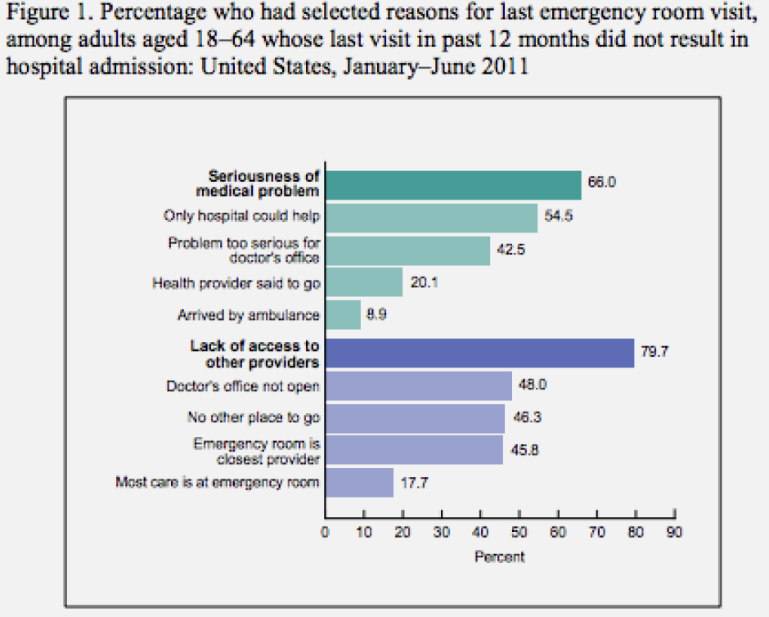
Emergency Department Healthcare Costs
Research Question 1
What factors impact the healthcare cost due to emergency department encounters?
Research Question 2
Is access to primary care providers associated with healthcare costs due to emergency department encounters?

Slide 4
Emergency Department Healthcare Costs
Study Population
Adults enrolled in Medicaid in 2011 in four southeast states
  Alabama, Arkansas, Louisiana, and North Carolina
  Medicaid is a low-income health insurance program
Data Source
Medicaid Analytic eXtract (MAX) claims files available from the Centers of Medicare and Medicaid Services (CMS)
Additional data sources: U.S. Bureau Census, Health Analytics Group at GT, Robert Wood Johnson Foundation, among others.
Disclaimer: This analysis of healthcare cost for the Medicaid population using the MAX claims data is in compliance with the study protocol approved by the Georgia Tech Internal Review Board (IRB) and by CMS. Do NOT use the data provided for this analysis for purposes other than the study in this lesson.

Slide 5
Response Variable
EDcost
  Primary variable of interest
  Emergency Department cost aggregated at the census tract level
  Depends on number of enrollees (members) and lengths of their enrollments
PMPM
  Per Member Per Month
  Total number of enrollment months aggregated by census tract
  Used to scale EDcost for comparison across census tracts
    Each census tract has different numbers of enrollees, and each enrollee can have a different length of enrollment
    Scaling EDcost by PMPM allows a comparison of cost per enrollee month

Slide 6
Predicting Variables
Location
  State and GEOID give state and census tract identification
Utilization
  Data must be scaled by PMPM
    ED (number of emergency department claims)
    HO (number of hospitalization claims)
    PO (number of physician office claims)
Population characteristics
  Percentages of Medicaid-enrolled adults of various populations
    BlackPop, WhitePop, OtherPop (race/ethnicity)
    HealthyPop, ChronicPop, ComplexPop (health conditions)
Socioeconomic and Health Environment Factors
  13 variables quantifying other possibly health-related factors
    Includes unemployment, median income, urbanicity of the census tract, access to primary care, health rankings, and others

Slide 7
Controlling Variables
Selection Bias
Adults with chronic or complex health problems tend to need emergency services more than the healthy population
Controlling factors
  ChronicPop (percentage of population with chronic conditions)
  ComplexPop (percentage with complex health problems)
Confounding Variable
The number of ED claims correlates with both response and predicting variables
It is a measure of the utilization of the emergency department
Utilization directly leads to ED healthcare costs
It is therefore a confounding variable
Do not include this confounding variable in the model

Slide 8

Summary

